Slide 1
The concept of self directed learning
Dr Mustafa Ibrahim
PG CertMedEd U and Wolverhampton
GP and GP trainer, West Midlands, England
Training Program director, West Midlands
GMC Associate

Slide 2


Learning a skill

Slide 3
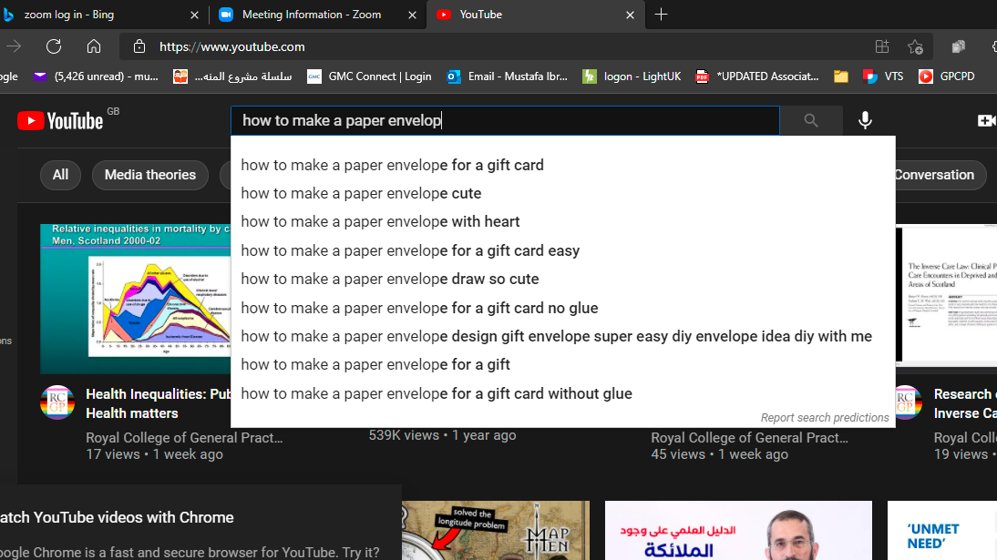

Slide 5
A different scenario
– A class by a teacher on making a paper envelope

Slide 6
What is SDL
The process by which the learner/s take responsibility of identifying their learning needs, use the resources to learn and evaluate their learning.

Slide 7
Stages of SDl
Identifying your learning needs
Setting the goals and identifying the resources
Learning
Evaluating
Reflecting

Slide 8
Identifying your learning needs
Khalid is brought to you by his mother because she noticed he has squint.
You noticed abnormality that looks like retinoblastoma.
What learning needs would you identify?

Slide 9
Identifying your learning needs
You are probably doing it already.
When you identify your learning needs, it is more likely to impact your practice
Motivation is at highest when learning needs is identified by you
Knowledge consolidates easily when it fits a question.

Slide 10
Stages of SDl
Identifying your learning needs
Setting the goals and identifying the resources
Learning
Evaluating
Reflecting

Slide 11
Setting the goals and identifying the resources
What is more important, the goals or the resources?

Slide 12
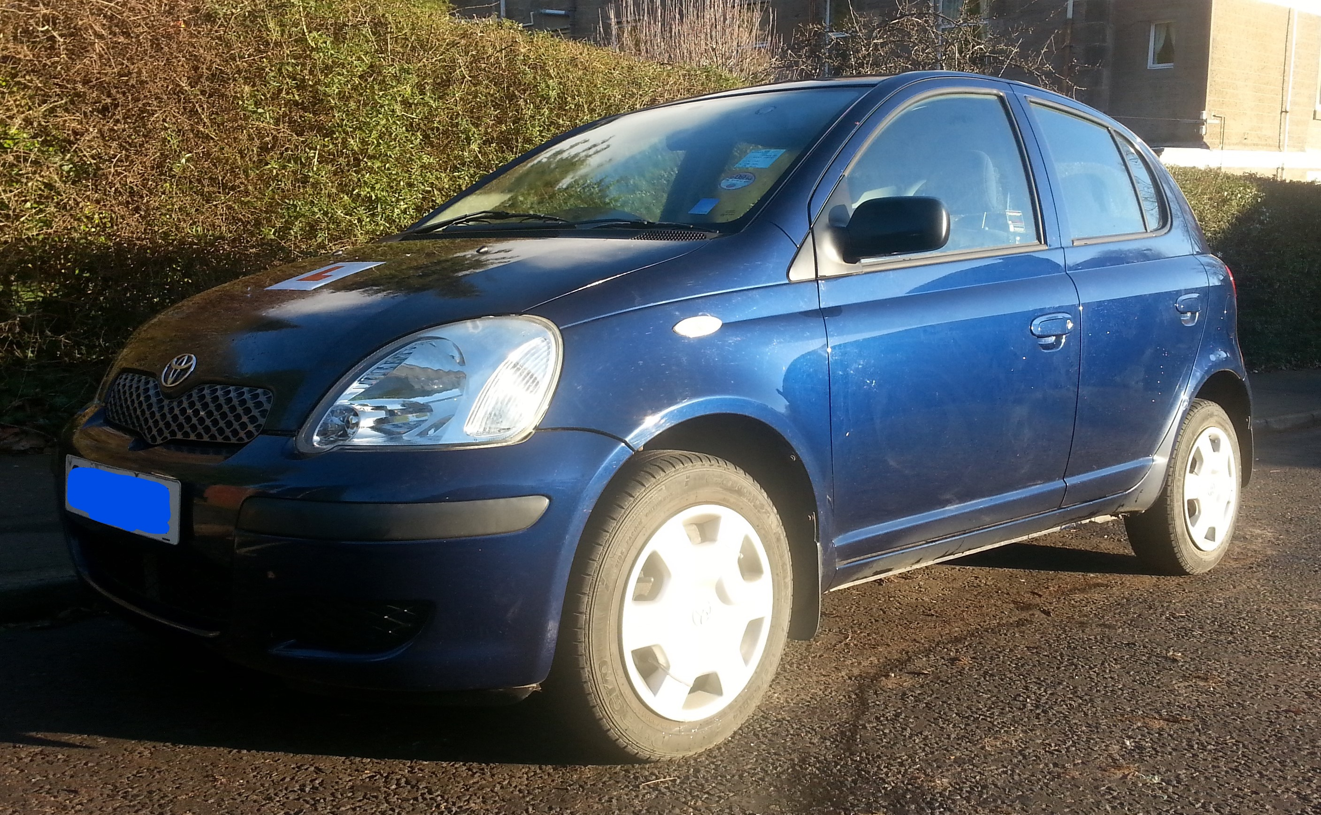
Competence based vs Objective based learning
A car manufacturer will follow all the appropriate technology and tools for your car but they cant guarantee the product.
Would you buy the car?

Slide 13
Identifying the resources
How much do we remember from:
  A lecture?
  A discussion?

Slide 14
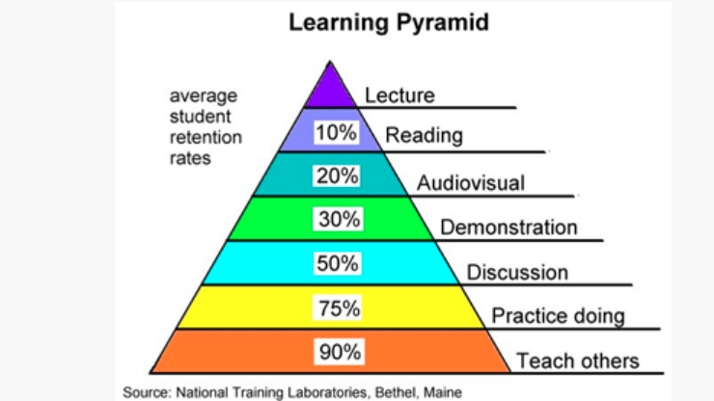

Slide 15
Stages of SDl
Identifying your learning needs
Setting the goals and identifying the resources
Learning
Evaluating
Reflecting

Slide 16
How to evaluate your own learning
Self assessment
Your own practice
Feedback

Slide 17
Benefits of SDL
Enables independent decision making
Improves communication skills
It facilitates competence based rather than objective based learning

Slide 18
Where to start
Ask the 5 SDL questions
Use the practical steps

Slide 19
The 5 SDL questions
1- What do I need to learn?
2- Why?
3- How will I use this knowledge?
4- Where can I find out what I need to know?
5- How will I know my learning was successful

Slide 20
Practical steps for SDL
Have a list ready of your learning needs (discussion: where would you keep the list)
Make sure the list is in line with your intended competencies for being a good GP.
Whenever possible, have the resources ready.
Assess your SDL weekly

Slide 21
Discussion

