Slide 1
Mind the gap
A mental journey with your IMG trainee
Dr Mustafa Ibrahim
MBBS, PG CertMedEd
GP and GP trainer
Training Program director
GMC Associate
GP appraiser
IMG

Slide 2

How many IMG trainees do you know?
The IMGs you know
Those trying

Slide 3
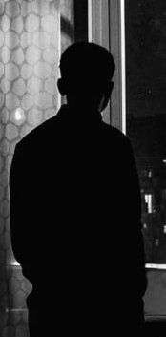
Insider tips for you to support your IMG trainee

Slide 4
9
Ensure they understand why they need to work harder

Slide 5
How long is the UK GP training?
To fill their training gap.

Slide 6
Tip 6
8
Help them burst their epistemic bubble

Slide 7


Slide 8
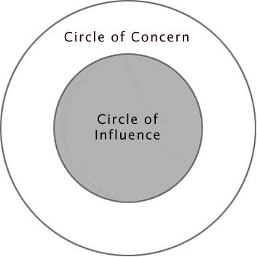
7
Help them focus on their circle of influence.

Slide 9
6
Do not shy away from talking about language

Slide 10
Remember
There is more to language than the literal meaning.
CSA /RCA is not language exams
= Rugby is not a running game.
Having an accent is OK (everybody has), what they need is the insight into their own accept

Slide 11
Tip 4 Consultations:
5
Watch them and be watched by them.
Reviewing their consultation notes may not be enough to tell how the consultation went.

Slide 12
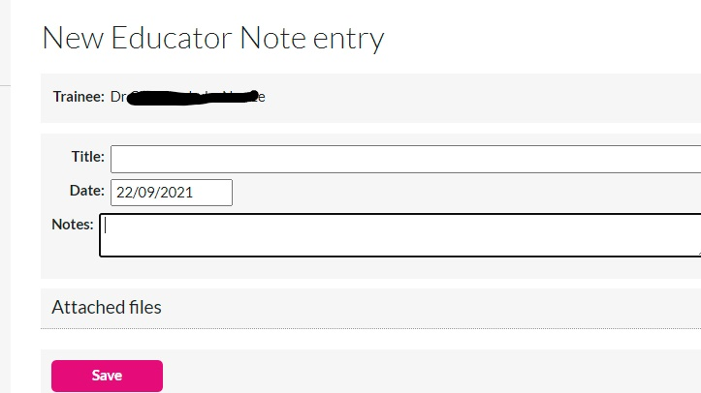
Feedback
4
If you can’t say it, the educator note is a bad short cut.

Slide 13
Tip 3
3
Show your culture awareness to get them on your side.

Slide 14
2
Beware of Q-risking your IMG trainee.

Slide 15
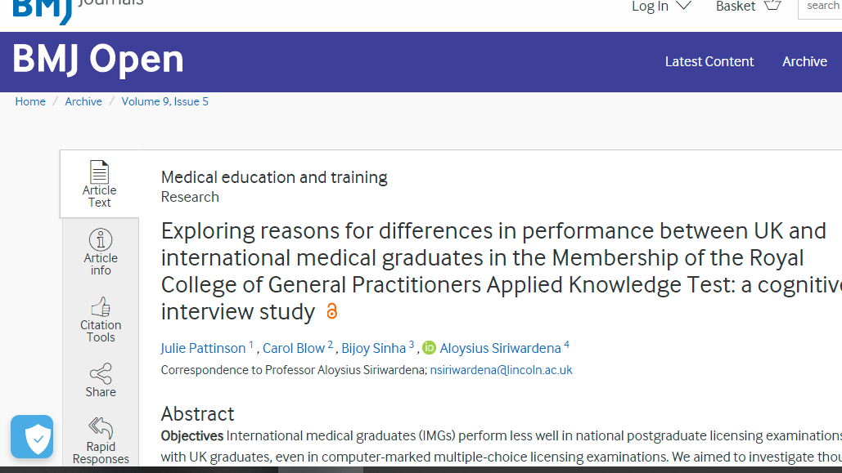
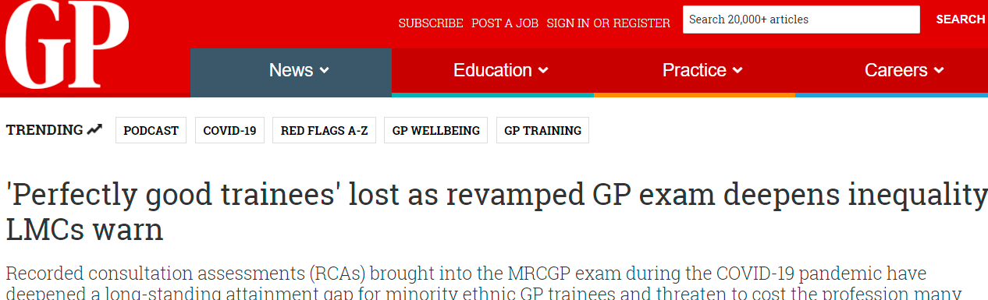
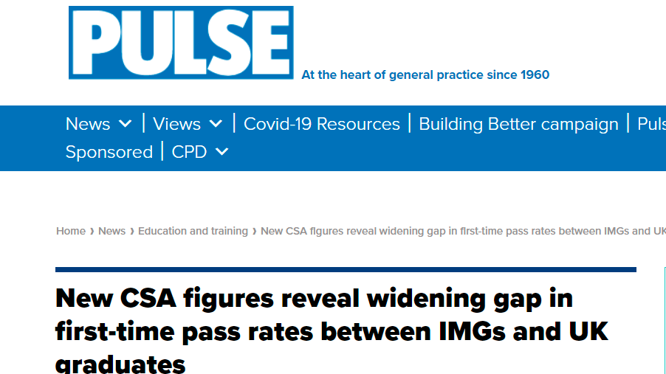

Slide 16
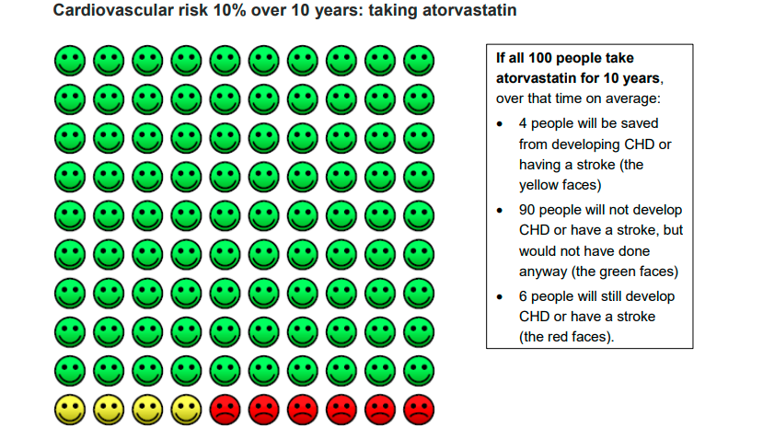

Slide 17
1

Slide 18
A man and his son were in a car accident. The man died in the way to hospital but the son was rushed to surgery. The surgeon looked at the boy and said: ‘’I can’t operate, that is my son’’
How is that possible?

Slide 19

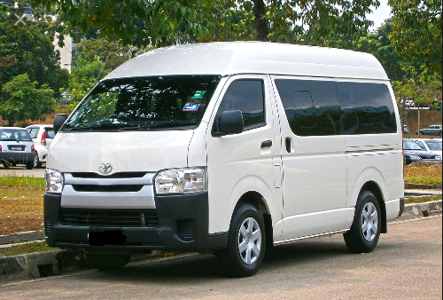
Representation
  Raj is 45 years old who works and lives in Birmingham. He is calm, analytical, methodical, and has attention to detail. He loves reading and drawing, wear glasses and had good performance in school.
  Question:
  Is Raj more likely to be a Geneticist or a Delivery driver

Slide 20
Tip 1
1
Mind the gap

Slide 21
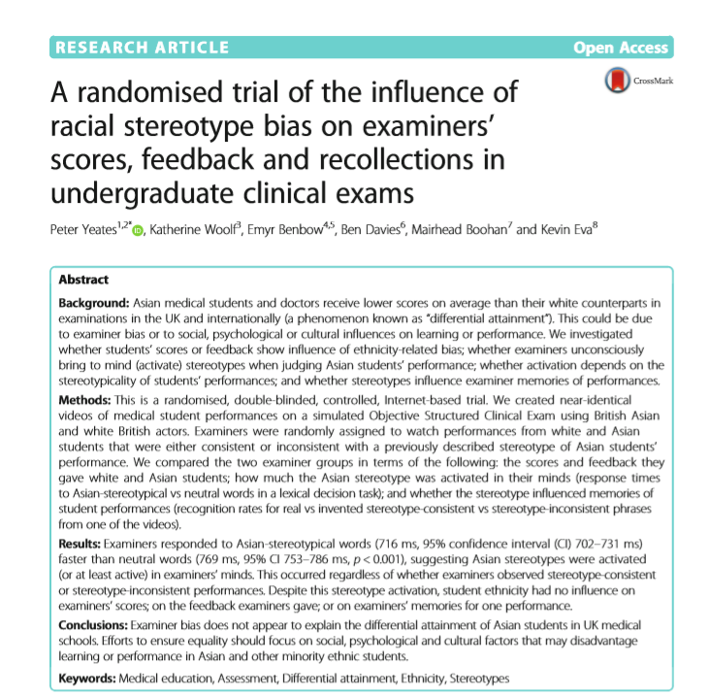

Slide 22
An IMG trainee question?
When is the best time for me to attempt sit my AKT?

Slide 23
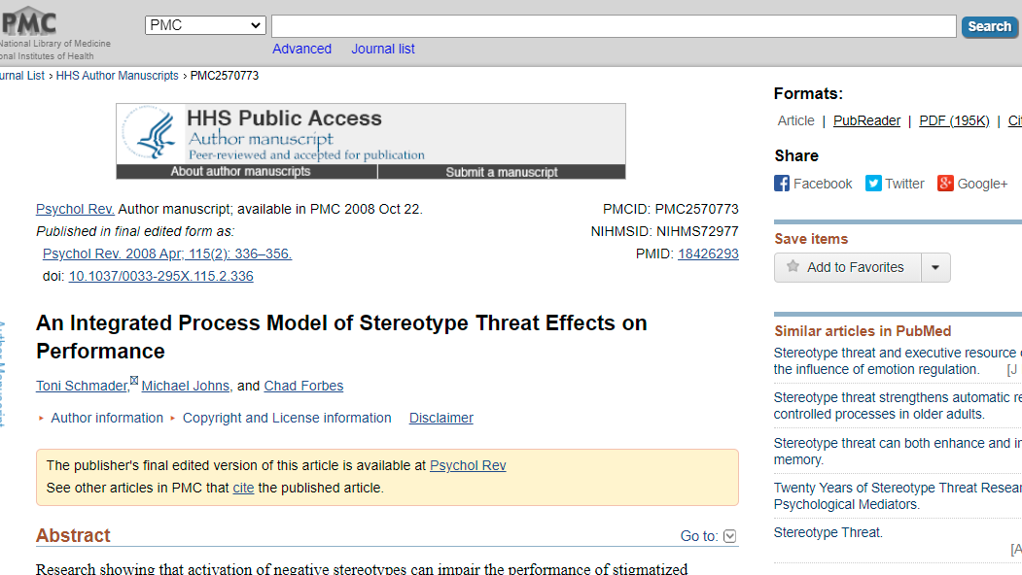
Stereotype threat

Slide 24
How to use DA stats for your trainee?
DA stats
Empowerment
Stereotype threat

Slide 25
Questions

