Slide 1
SecondaryCare4PrimaryCare
Super-Condensed GP Curriculum Guide
Courtesy of South East Scotland 2013
CSR
CS/Trainee meetings action planning
Learning Opportunities
Confidence Rating Scale
A Guide for Hospital Clinical Supervisors
Log In
We are the Local Education and Training Board for the West Midlands
Developing people for health and healthcare
www.hee.nhs.uk
letb@westmidlands.nhs.uk
@WestMidsLETB

Slide 2
SecondaryCare4PrimaryCare
Username
Password
Role
Next
Developing people for health and healthcare

Slide 3
SecondaryCare4PrimaryCare
Super-Condensed GP Curriculum Guide
Courtesy of South East Scotland 2013
CSR
CS/Trainee meetings action planning
Learning Opportunities
Confidence Rating Scale
Supervisor Edition
Next
We are the Local Education and Training Board for the West Midlands
Developing people for health and healthcare
www.hee.nhs.uk
letb@westmidlands.nhs.uk
@WestMidsLETB

Slide 4
SecondaryCare4PrimaryCare
Introduction
The Super Condensed Curriculum Guide has been created as a package to be used by both Clinical Supervisor and GP Specialty Trainees in order to support hospital units and their attached Clinical Supervisors deliver an educational experience of the highest quality feasible that is relevant to the GP trainee, thus improving consistency of approach and outcome throughout the region.
Next
Developing people for health and healthcare

Slide 5
SecondaryCare4PrimaryCare
Rationale
Next
Developing people for health and healthcare

Slide 6
SecondaryCare4PrimaryCare
The Guide
The Guide highlights areas of curriculum relevant to the specialty and groups these into “geographical” areas where learning needs might be achieved e.g. acute, chronic, community, as well as including core skills and technical skills to be achieved. It also makes suggestions for additional learning opportunities within the post e.g. teaching and audit.
Some posts offer opportunities for learning that relates to other areas of the curriculum, and these are highlighted. The idea is that this would inform the supervisor and stimulate discussion regarding possible learning needs
and how these might be addressed -for example, that the trainee may need to attend outpatient clinics or community day hospitals to fulfill learning needs which cannot be met on the wards.
Next
Developing people for health and healthcare

Slide 7
SecondaryCare4PrimaryCare
The flowchart
The supervisor meeting flowchart clearly lays out the tasks for each meeting and the preparation needed before and after each. This is to aid CS and trainee to create both a structure and a timeline for discussion and the workplace based assessments. The hope is that this would enable a more focussed and confident approach to identifying and meeting objectives in trainee education and assessment.
Next
Developing people for health and healthcare

Slide 8
SecondaryCare4PrimaryCare
Roles and Responsibilities of Clinical Supervisors
Oversee day to day work of the trainee (direct contact or delegated)
Hold 3 formative meetings with the trainee using the “Super Condensed” Curriculum Guide (gather and collate information from other sources)
Sign off Workplace based assessments (WPBA) 3 x Case Based discussions (CBD)
3 x Mini-Clinical Evaluation Exercise (Mini-CEX) Direct Observation of Procedural Skills (DOPS) Multi-source feedback (MSF) 5 clinicians only
NB assessments can be undertaken by other appropriate members of staff: Associate specialists, staff grades, enhanced nurse practitioners, specialty trainees >ST4
Next
Developing people for health and healthcare

Slide 9
SecondaryCare4PrimaryCare
Roles and Responsibilities of Clinical Supervisors
Ensure trainees are aware of their responsibilities for patient safety
Be the trainee’s initial point of contact for specific issues relating to their post
Support the trainee in attending GPST focussed educational opportunities:
Communicate and record appropriately any concerns about a trainee’s progress and development to their GP Educational Supervisor and TPD
Complete a Clinical Supervisors report (CSR) at the end of placement
Next
Developing people for health and healthcare

Slide 10
SecondaryCare4PrimaryCare
2
Timeline for CS / trainee meetings
Preparation
Trainee looks at
“super-condensed” guide
& confidence rating scale for specialty & identify any issues that need to be discussed
Review the previous CSR
Initial Meeting
Trainee & Clinical Supervisor meet within 2 weeks of starting post
Discuss ideas, concerns & expectations for the post and how to focus learning in areas of identified needs.
Discuss plans for GPST HBGL attendance in this post.
Complete a brief learning plan together, trainee documents in the e-portfolio learning log and creates a pdp for each category.
Clinical Supervisor documents brief summary of meeting in the educator notes.
Both set dates and times for completion of relevant WPBA assessments
Set date and time for mid post review
Mid Post Meeting
Review progress with action plan, confidence rating scale, MSF (if required) and consider pointers for needs
Discuss general progress using the RDMp model as a guide (see CSR)
Clinical supervisor documents in educator notes and trainee documents in e-portfolio learning log and updates pdp and learning plan
If any concerns contact the trainee’s GP Educational Supervisor/GP unit or TPD
Towards the End of the Post
The final meeting should have occurred by January or mid June prior to the ARCP panel meeting
Review progress with mandatory elements of WPBA and any further evidence including audit & SEA
Complete CSR documentation If any concerns contact the
trainee’s GP Educational Supervisory/GP unit or TPD
Trainee completes the Deanery post assessment questionnaire (PAQ)
August or February
August or February
Assessments
End October or April
Assessments
January or Mid June
CSR
Next
Developing people for health and healthcare

Slide 11
SecondaryCare4PrimaryCare
The RCGP Curriculum for GP Training
Next
Developing people for health and healthcare

Slide 12
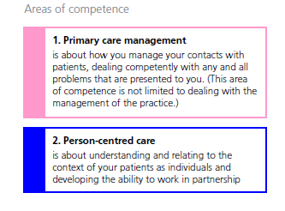
SecondaryCare4PrimaryCare
Areas of competence - 1
Next
Developing people for health and healthcare

Slide 13
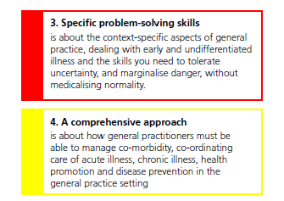
SecondaryCare4PrimaryCare
Areas of competence - 2
Next
Developing people for health and healthcare

Slide 14
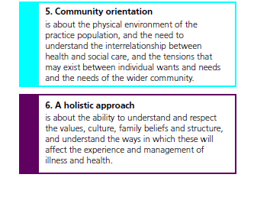
SecondaryCare4PrimaryCare
Areas of competence - 3
Next
Developing people for health and healthcare

Slide 15
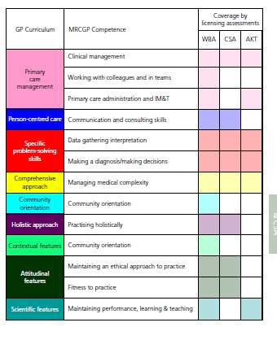
SecondaryCare4PrimaryCare
How they are assessed
Next
Developing people for health and healthcare

Slide 16
SecondaryCare4PrimaryCare
Providing Learning Opportunities in Specialty posts
Click on your specialty
Obstetrics and Gynaecology
Emergency Medicine
Paediatrics
Psychiatry
Medicine
Care of the Elderly
Palliative Care
ENT
Ophthalmology
Communicable Diseases
Trauma and Orthopaedics
Rheumatology
Next
Developing people for health and healthcare

Slide 17
SecondaryCare4PrimaryCare
Paediatrics
2
Acute
OBSTETRICS
Pregnancy problems inc. bleeding, pain, pre-eclampsia
High Risk cases
Abnormal labour & delivery
GYNAECOLOGY
Pelvic pain, vaginal discharge
O&G
Chronic
OBSTETRICS
Ante & post natal care
Medical problems in pregnancy
Sexual Health Clinic
Breast lumps etc
DVT/PE
Mood disorders e.g. puerperal psychosis
Colposcopy clinic
Psychosexual counselling
Men’s health
GYNAECOLOGY
Menopause
Continence
Gynaecology malignancy
Infertility
Vulval problems
Community/MDT
Liaison with MDT
Awareness of other agencies – roles and remit e.g. HV, Social workers, police, allied health care professionals,
Incontinence service e.g. physio services
Sexual Health Clinic
Community pharmacy
Core Themes
Communication and Consultation
- gynaecological & obstetric history, sexual history and pre-test HIV counselling
The normal and the abnormal - normal pregnancy & delivery, cervical cytology
Prescribing - prescribing in pregnancy
Teamworking - Medicine, midwifery, specialist services
Health promotion & prevention – pre-pregnancy screening including genetics, pre-natal counselling, parenting skills, breast-feeding
Medico-legal/Ethics - TOP, fertility issues, genetic counselling, teenage contraception, sexual partner contact tracing
Technical Skills
LARC
Cervical smear & cytology
Speculum examination & VE
Catheterisation
IV insertion & antibiotic preparation
Normal delivery
Other Opportunities
Out of Hours in GP
Outpatients/specialised clinics e.g. CTG clinics, Gynaecology ultrasound clinics
Perinatal morbidity and mortality meetings
Early pregnancy advice service
Family planning clinic
Tips
Audit incl. audit afternoons
Significant Event Analysis
Clinical governance
Risk Assessment
Dr as teacher
Leadership
Developing people for health and healthcare
Next

Slide 18
SecondaryCare4PrimaryCare
The Clinical Supervisors Report
Guide to Clinical Supervisor Report
This report should be completed as part of the last appraisal meeting with your trainee prior to their 6 monthly review with their GP Educational Supervisor, or at the end of each 6 month placement (see timeline on flow chart). The e-Portfolio has a section for the Clinical Supervisor to write a short structured report on the trainee at the end of each hospital post.
Next
Developing people for health and healthcare

Slide 19
SecondaryCare4PrimaryCare
The Clinical Supervisors Report
The Report covers:
The knowledge base relevant to the post;
Practical skills relevant to the post
The professional competencies, grouped into 4 –
Relationships, Diagnostics, Clinical Management, Professionalism
This is based on the level that you would expect an ST trainee to have
i.e. ST1 or ST2.
The electronic form provides reminders of the definitions of the competences to make writing the report easier (word pictures).
It may also be helpful to refer to the relevant curriculum statement(s) on the RCGP website in reporting on the knowledge and skills relevant to the post.
Next
Developing people for health and healthcare

Slide 20
SecondaryCare4PrimaryCare
The Clinical Supervisors Report
The report should identify and comment on:
Any significant developmental needs identified during a placement, and also point out any areas where the trainee has shown particular strengths.
The progress of the trainee in terms of the evidence of competence (it is not a pass/ fail report).
If there are serious issues of professional performance or ill health during a placement these will need to be handled by normal acute trust/ PCT/ Deanery mechanisms
Next
Developing people for health and healthcare

Slide 21
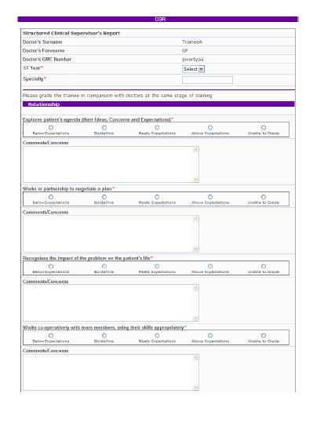
SecondaryCare4PrimaryCare
Examples of Clinical Supervisor Reports
Good
Next
Developing people for health and healthcare

Slide 22
SecondaryCare4PrimaryCare
Examples of Clinical Supervisor Reports
Not so helpful
Next
Developing people for health and healthcare

Slide 23
SecondaryCare4PrimaryCare
Examples of Clinical Supervisor Reports
Excellent
Next
Developing people for health and healthcare

Slide 24
SecondaryCare4PrimaryCare
Completing the Report
Completing assessments or CSR electronically
The simplest way is to go to:
https://eportfolio.rcgp.org.uk/login.asp
click on the Assessment form page
complete the details page and click on CSR at the bottom. complete the form with the trainee present and submit.
Or you can log in with your RCGP login details to:
https://eportfolio.rcgp.org.uk/login.asp
Select your trainee
Left hand navigation bar > click evidence
Scroll down to find the relevant post Click under CSR (hand with pen)
Complete documentation with trainee present and submit
Next
Developing people for health and healthcare

Slide 25
SecondaryCare4PrimaryCare
Certificate of Completion
Click here to download your certificate of completion
Next
Developing people for health and healthcare

Slide 26
SecondaryCare4PrimaryCare
Feedback
Any questions, comments , or feedback?
Sign Out
Developing people for health and healthcare

